Slide 1
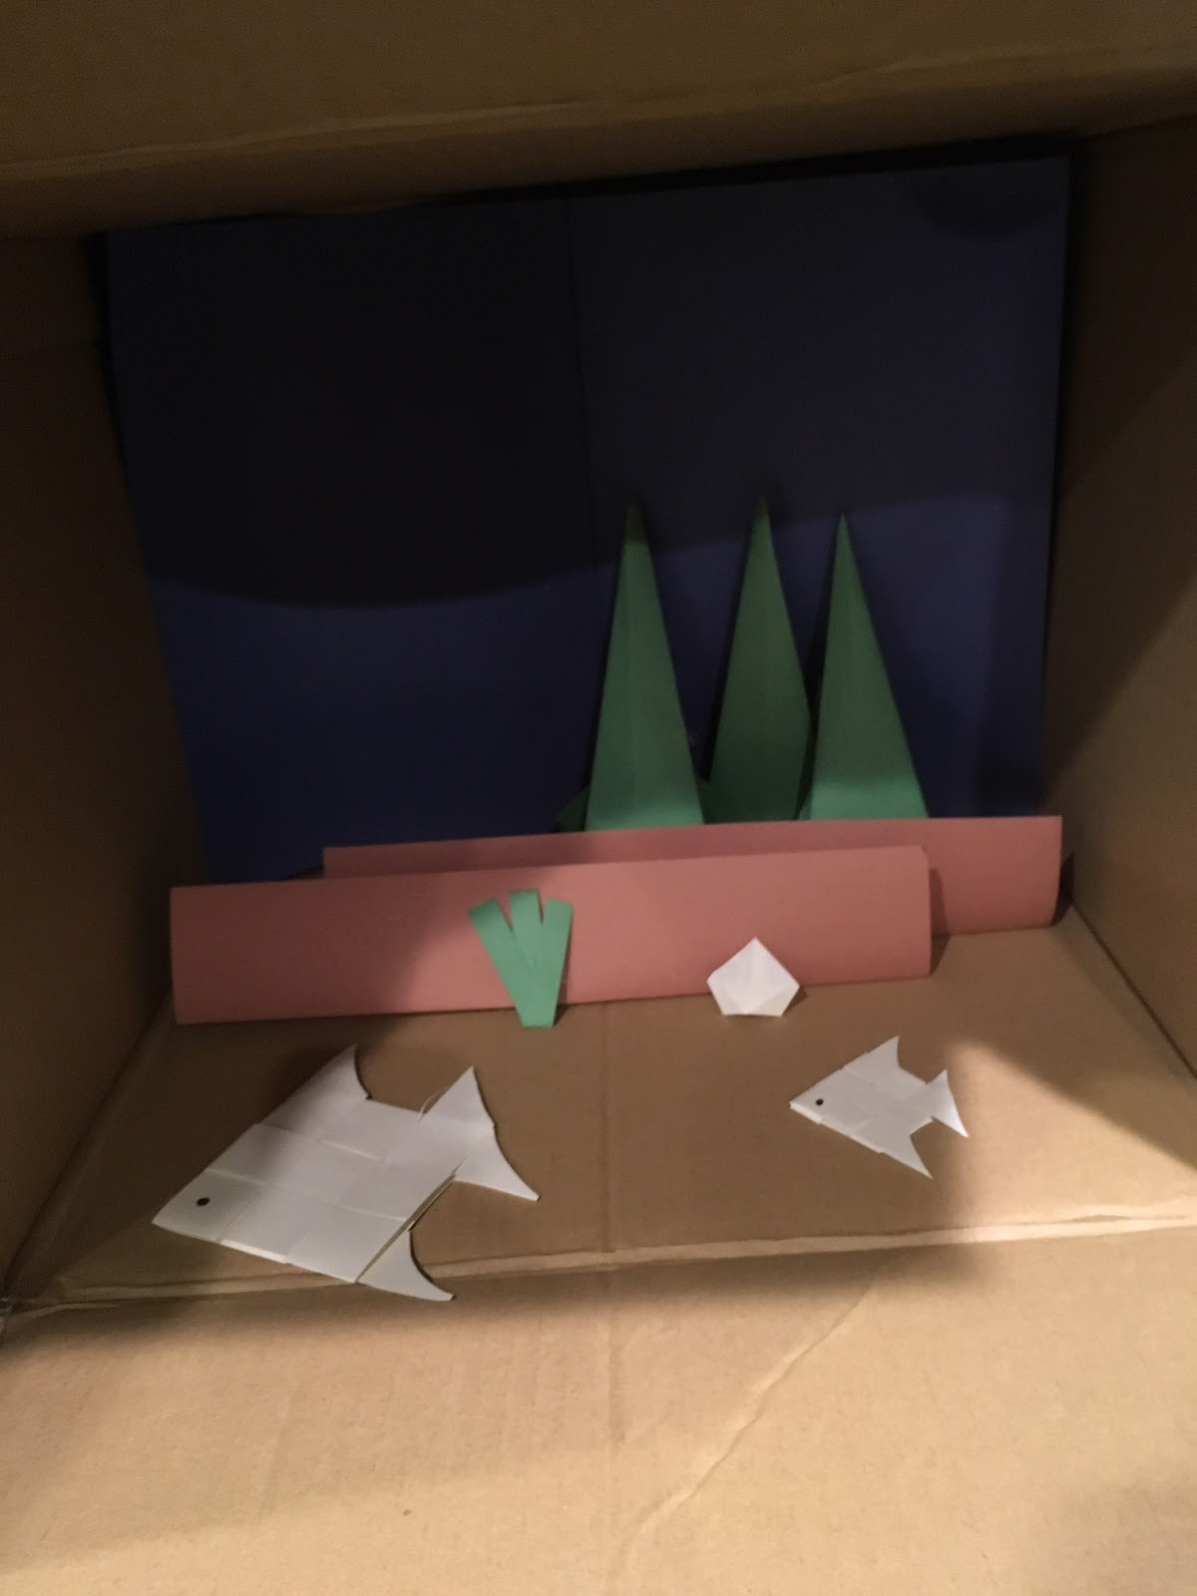

Step 1: Add Scenery
Without Scenery
With Scenery

Slide 2
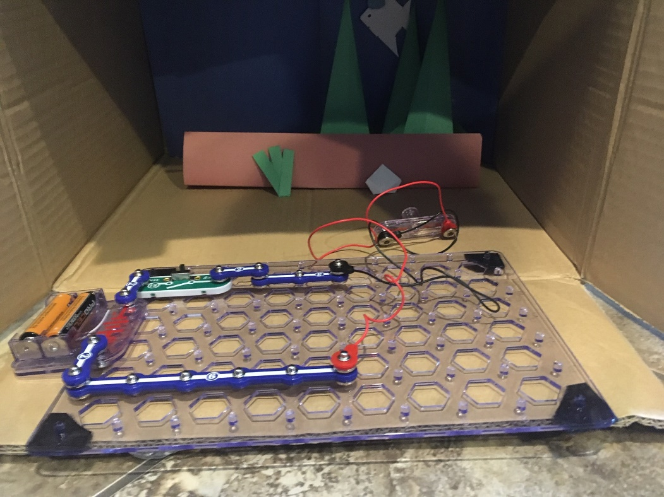

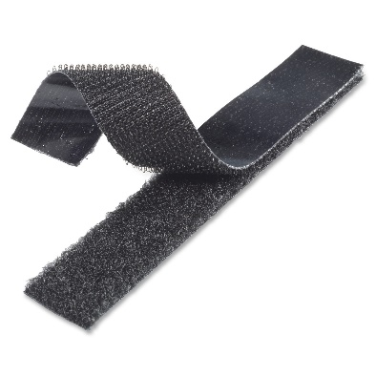
Step 2: Add Circuits
Top
Left
Back
Right
Bottom
Create a Circuit
(Movement, Light, Sound)
Use Velcro's to Attach Your Circuit and Jumper Wires for the Actuator

Slide 3
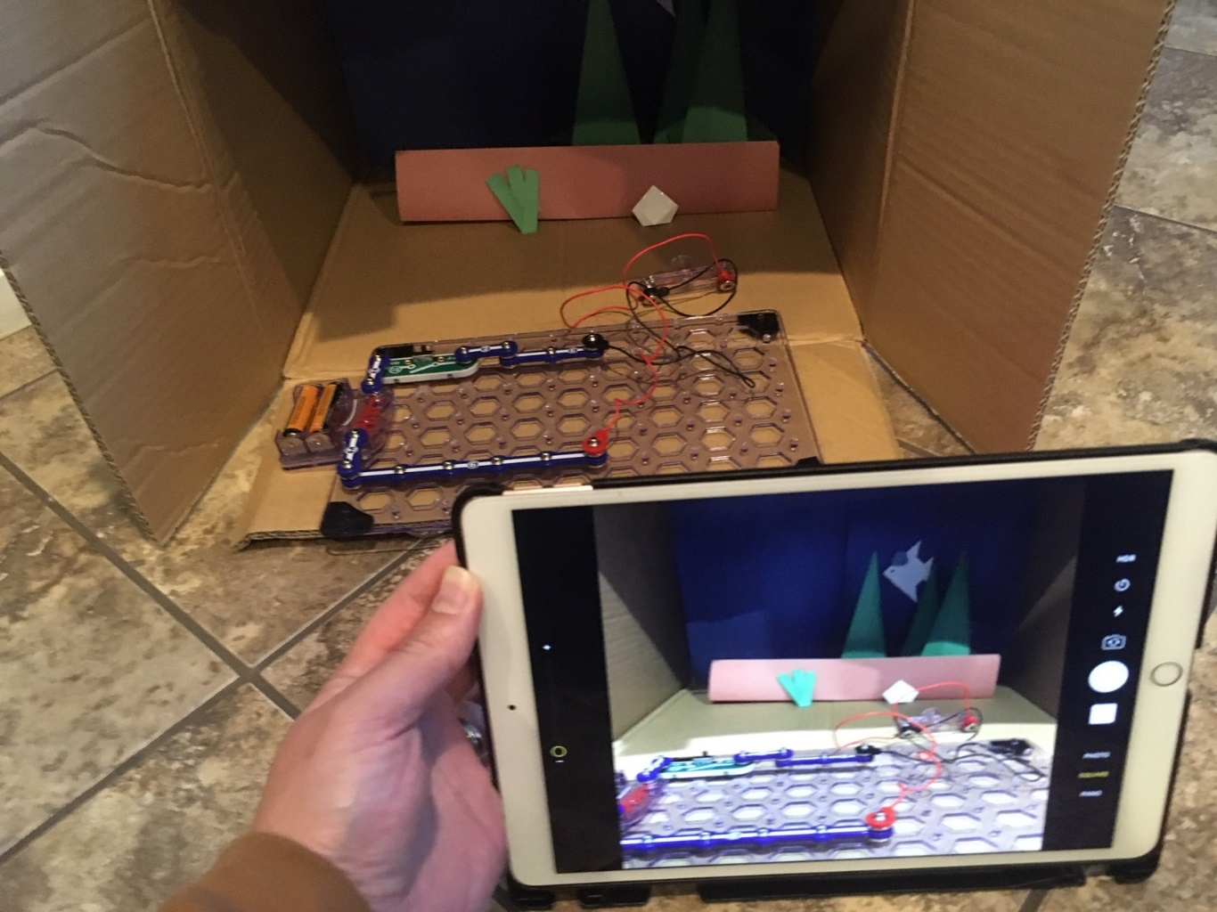
Step 3: Retell Your Story
Video Record
Retelling the Story

Slide 4
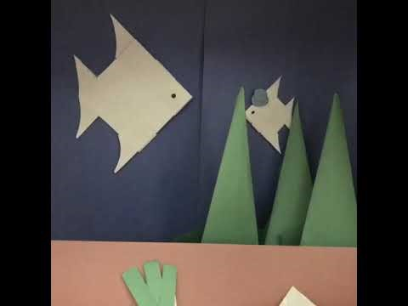
Example Project

